Slide 1
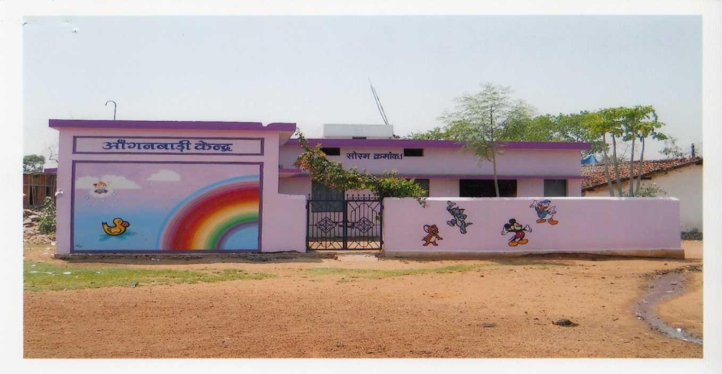
ICDS Strengthening & Restructuring
National Orientation & Consultation
with States/UTs
12 January 2013
MINISTRY OF WOMEN AND CHILD DEVELOPMENT
GOVERNMENT OF INDIA

Slide 2
ICDS strengthening & Restructuring : The context
Issue of quality
SNP coverage & quality sub-optimal
Pre-school education quality & curriculum needs improvement
Monitoring & Supervision is weak
Training systems requires strengthening & overhauling
Weak Infrastructure
Convergence a challenge
Real universalization !!!
Projects: 7005 / 7076
AWCs: 13.20 L/14.00 L
Ground mapping & population norm not at optimum level,
Coverage of 75 million against 158 million children (2011)
Endeavor to cover all children
1400000
2012-13-14
1317000
7076 Projects
2011-12-13
706800
7005 Projects
2005
290655
5422 Projects
101864
1995
ICDS Milestones – Number of Projects & AWCs sanctioned / approved
3066 Projects
1985
4891
896 Projects
Achievement during Eleventh Five Year Plan
32.88% increase in beneficiaries for SN
18.96% increase in beneficiaries for PSE(including 180 lakh girl child)
Expansion in last 7 years (2005-12) double the number of AWCs and addition of 2000 new ICDS projects.
1975
33 Projects

Slide 3
ICDS Strengthening & Restructuring : The context
In view of PM’s National Council on India’s Nutrition Challenge decision (Nov 2010) A comprehensive proposal for ICDS Strengthening and Restructuring was prepared incorporating the core principles and recommendations received from NAC ( 6, June 2011) & the IMG report of Planning Commission.
The Govt. of India approved ICDS restructuring as well as allocation of Rs1,23,580 Cr for ICDS Mission during 12th Plan
A/A was issued on 22nd October 2012 along with ICDS Mission-Broad Framework of Implementation
The strengthening & restructuring of ICDS has three facets:
Reforms-Programmatic, management & Institutional
New components & initiatives
Revision of existing norms

Slide 4
Programmatic Reforms
Repositioning the AWC as a “Vibrant ECD centre” to:
Become the first village outpost for health, nutrition and early learning
Operate for minimum of six hours of working, etc.
Construction of AWC Building, appropriate infrastructure (including revision of rent), up-gradation, maintenance, improvement and repair of AWC building.
Strengthening Package of Services
Strengthening ECCE,
Focus on under-3s
Care and Nutrition Counselling service for mothers of under-3s
Management of severe and moderate underweight through SNEHA SHIVIR
Improving Supplementary Nutrition Programme with revision of cost norms.
Strengthening training system .
Provision of Technical Assistance at all levels.

Slide 5
Management Reforms
Decentralized planning, management and flexible architecture; Introduction of APIP and flexibility to States for innovations.
Addl. Worker in 200 high burden districts and Link workers in others district on demand by State/UT
New Staffing proposed for ICDS Mission as per the programme phasing plan; two technical persons for states not covered in phasing plan during initial 2 years.(Subject to final approval)
Introducing new items– pool of untied fund (for promoting voluntary action, local innovations, provision for children in special needs etc).
Strengthening governance – including PRIs, civil society & institutional partnerships up to 10% projects.
Strengthening of ICDS Management Information System (MIS).
Using ICT – Web enabled MIS and use of mobile telephony & others.
Ensuring convergence at all the levels including the grassroots level.

Slide 6
Institutional Reforms
ICDS in Mission Mode:
ICDS Mission at National level,( NMSG, EPC), Mission/Society at State level with units at District (SMSG,SEPC) with powers & systems for financial, human resource, logistics and procurement, programme operations and monitoring etc.
Planning & implementation of state specific plans with measured inputs, processes, outputs and outcomes
Shared programmatic and resource commitments through MoU and APIPs
NMSG to report to the PM’s Council at national level and similarly State missions (SMSG) to the CMs at the State level as well as to the NMSG

Slide 7
What’s New?

Slide 8
Goal of ICDS Mission
The ICDS Mission targets would be to attain three main outcomes namely:
Prevent and reduce young child under-nutrition (% underweight children 0-3 years) by 10 percentage point;
Enhance early development and learning outcomes in all children 0-6 years of age; and
Improve care and nutrition of girls and women and reduce anaemia prevalence in young children, girls and women by one fifth.
Contribute towards reduction in IMR, MMR, LBW and CSR in convergence with NRHM
Annual Health Survey (AHS) and District Level Household Survey (DLHS) to be used as baseline for measuring the outcomes of ICDS mission.
Notes:
Note: Actual implementation on full scale will commence from 3rd year and may spill over to 4th and 5th year

Slide 9
New Thrust Areas
Re-designed package of services
Focus on under -3 children, Care & Counseling & early stimulation
Early Childhood Education and Development /PSE
Focus on impact, outcomes and results indicators (Refer Annex 7 of BFI)
Service standards for ICDS prescribed (ref. Annex 8 of BFI)
Programmatic and Thematic convergence (ref. Annex 9)
Mission review with participation from civil society
Voluntary action- Promoting nutrition, ECCE, Child Development etc. through partnership with institutions
Greater Community participation
Provision of Jan-Sunvai, social audits and disclosures

Slide 10
Reaching U-3, Pregnant, Lactating Women
- Home based care and nutrition counseling for pregnant and
lactating mothers, and mothers of under three
Additional worker in 200 high burden districts
Community based care for undernourished children
Improved growth monitoring and counseling, mother child tracking through self monitoring family retained joint mother child card
Village Health and Nutrition Days in Convergence with NRHM
Stronger referral linkages with health
Community based monitoring
Increased duration (6 hours) of AWCs
AWC cum Crèche in 5% of AWCs (70,000)
Public education and awareness , IEC and Community mobilization

Slide 11
Phasing of Strengthening & Restructuring of ICDS
Phasing plan for the implementation of ICDS Mission:
First year of XII plan (2012 – 13): 200 High Burden districts
Second year of XII plan (2013 – 14): Additional 200 districts incl. Special Category states. Total 400 districts.
Third year of XII plan (2014 – 15): Remaining districts. (Full scale)
District Units, SNP norms & new components to be rolled out as per above phasing plan.

Slide 12
Fund Flow Mechanism
Two installments: Second after approval of APIP and UC of previous year and SOE of first installment.
Fund of the ICDS Mission to be channeled through the Consolidated Fund of the State; with provision of fund transfer within 15 days; Interest penalty for delay
Centre – State cost sharing pattern of all new
components including new staff to be 75:25, other than
NER, where it will be at 90:10;

Slide 13
Construction, Maintenance & Up-gradation of AWCs
Construction of 2 lakh AWC buildings@ Rs 4.5 lakh per unit;
Mandatory convergence with MNREGA- to quickly bridge the large requirement and gap
( REFER LETTER FROM SECRETARY MWCD DATED 17.12.2012 TO CS’)
Separately, Perspective plan for construction of AWCs in convergence with various other schemes.
Fund for maintenance of existing Govt. owned & non rental AWC buildings be provided at Rs.2000/- per annum/bldg
Up to Rs.One Lakh per AWC- For improvement and up gradation ( Additional rooms for Crèche, other facilities (kitchen, store, ANC facility etc.)
Rent: Up to Rs. 750- Rural & Tribal areas, Urban areas- Rs. 3000, Metro-5000 per month.

Slide 14
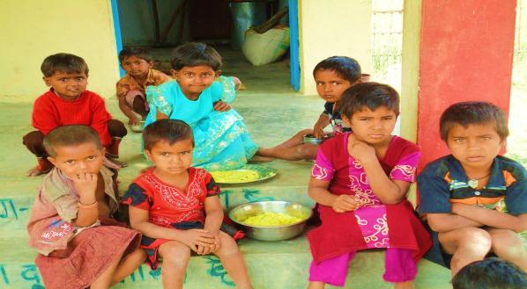
Revision of norms
SNP Norms
Category | Existing Norms (w.e.f. 16.10.08) | Approved norms effective from the date of approval as per phasing plan (per beneficiary per day)
(i) Children (6-72 months) | Rs.4.00 | Rs.6.00
(ii) Severely underweight children (6-72 months) | Rs.6.00 | Rs.9.00
(iii) Pregnant women and Nursing mothers | Rs.5.00 | Rs.7.00
Cost norms for other existing components such as PSE Kits, Medicine kits,
monitoring, rent of AWCs etc. have been revised. ( ref. Annex2 of Administrative
Approval)
Other existing norms of ICDS Scheme shall continue in existing form (refer Annex 3 of
Administrative Approval)
Purchase of vehicle only for NER

Slide 15
ECCE in Strengthened and Restructured ICDS
4 hours of play and activity based non formal preschool education with a developmentally appropriate ECCE curriculum for 3-6 year olds.
The transaction of the above curriculum would be facilitated by the revised PSE Kit @ Rs 3000 and activity books for children
Early stimulation programme for under 3s to foster their holistic development
Early detection of delayed developmental milestones; early intervention for children with special needs
Assessment of children to ensure that the programme is responsive to the developmental needs of the child
Monthly fixed village ECCE day for community and parent involvement and advocacy.

Slide 16
ECCE/PSE
National ECCE Curriculum Framework Contextualized and being piloted for 2 months in 16 states in 25 Anganwadi Centres respectively in 2 ICDS projects (1 rural/tribal and 1 urban) of each of the selected States/UTs.
PSE Kits to be issued at the revised rates to the AWCs participating in the pilot

Slide 17
Strengthening Training System
Setting up of training cells at state level
State training Institutes for ICDS in 10 states
Strengthening of NIPCCD through Training Resource Centre for ICDS
Strengthening of MLTCs and AWTCs-Monitoring & Accreditation
Revision and development of course curricula/modules/training and learning materials
Up-gradation of training facilities
Training Need Assessment (TNA)
Revision of financial norms (Ref. BFA)

Slide 18
Provision of Untied Funds
Innovation
Additional AWW
Link worker
Anganwadi cum Crèche
Children with special needs
Voluntary action
Sneha Shivir
Details of allocation under each head has been given in BFA Annex XIX

Slide 19
AWC cum Crèche
AWC cum Crèche in 5% of the AWCs-(70, 000)
Pilot to be initiated under different models: viz.
Common Rajiv Gandhi Crèche Scheme & AWC- States to tie up with CSWB, ICCW ?
AWC cum Crèche in urban and rural areas- Models with Mobile crèches and their associates (NIPCCD to coordinate and support pilot) in 10 ICDS projects commencing February 2013
Convergence with MNREGA in identified job demand areas?
States may identify any other model suitable to their areas and may suggest pilot.
States may extend support to NIPCCD & NGOs .

Slide 20
Suggested list of NGOs
STATE | NGO | PROJECT
Gujarat | CHETNA | One tribal, one rural
Madhya Pradesh | Vikas Sanvad Samiti | One tribal, one rural
West Bengal | CINI | Urban
Chhattisgarh | Jan Swasthya Sahyog | Tribal
Rajasthan | Sewa Mandir | Rural, urban
Orissa | Centre for Youth and Social Development | Tribal
Delhi | Mobile Crèches | Urban

Slide 21
Convergence
Convergence with NRHM, TSC, DWS,MNREGA, HUPA, SSA, PRI, Social Justice, Food, I&B etc. as detailed in Annex IX & IX-A of the BFI

Slide 22
GOI-Steps Initiated
Administrative approval and Broad Framework of Implementation for the strengthening & restructuring ICDS issued.
Orders regarding Constitution of NMSG, EPC and National Mission Directorate issued
National orientation workshop of State Secretaries for orienting them towards implementing Restructured ICDS
Broad indication on each component is given in Broad Framework for Implementation
Formulation of further guidelines, manuals on various components and aspects of strengthening & restructuring ICDS -Ongoing

Slide 23
Steps Initiated contd..
Preparation of Operational and financial guidelines-Ongoing
Memorandum of Understanding (MoU) to be signed between Centre and State
Financial Monitoring formats
Creation of separate budget heads for micro level monitoring
Establishment of online Nutrition Resource Platform (NRP)
Online portal for MIS
Preparation of Human Resource guidelines for newly approved staff and process for getting clearance from MOF
Issued order for submission of APIP with revised setup of ICDS Mission

Slide 24
Steps Initiated contd..
Revised MIS including formats &registers and rollout initiated.
Pilots testing of web based online MIS and all States have been requested to switchover to web based MIS, states to give coding for each AWC latest by 31st January.
Pilot on data collection of AWMPR on select indicators through IVRS (NRP) and Knowledge network.
ECCE policy formulated; Pilot testing of ECCE Curriculum –ongoing; Policy, curriculum framework and standards finalized- Approval by end of current financial year
Proposal for creation of posts sent to MoF (personnel)
Annual Programme Implementation Plan introduced – Deadline-March 15 for 2013-14

Slide 25
Action points for states

Slide 26
Action points for states
Take approval of state cabinet for S&R of ICDS including cost ratio, financial norms and allocation of funds.
Preparation of APIP
MoU to be signed between Central and State Govt./UT.
Set up State Mission Steering Group (SMSG) and the state Empowered Programme Committee (SEPC)
Appoint a State Mission Director
Plan activity for construction of AWC buildings-Identification of AWC, allotment of land, laying design, cost estimates, budget provision, etc.
Identify AWCs for up-gradation and draw maintenance plan
Identification of the existing AWCs to be converted into AWC cum creche.

Slide 27
Action points for states contd.
Apply revised cost norms on existing components without waiting for complete roll out.
Revise training norms.
Constitute the State Child Development Society along with a district unit in each of the districts.
Commitment for roll out of revised MIS- Latest by September 2013
Migration to WHO growth standards and use of MCPC cards by all AWCs-(Mandatory declaration required from states)

Slide 28
Action points for states contd.
Plan and project requirement of additional worker/link worker to be provided on demand by state govt. duly approved through APIP by the EPC under the ICDS mission
Fill the vacant posts through job contract from outsource/placement agencies on a temporary basis till such time the regular posts are filled,
Notify 5-tier monitoring system establishment as per GOI guidelines ( 20 States have already constituted at all levels )
Issue instructions for minimum 6 hours working of AWC universally (Timings may vary from place to place)
Ensure convergence with NRHM for health checkup
Send proposals for establishing district ICDS cells wherever not established.

Slide 29
Action points for states contd.
IYCF/IEC promotion activities
Training need identification for staff at all levels as well as AWW,AWH
Creation of separate budget heads for:
ICDS(G) – 1. Staff salary, 2. Honorarium, 3. Components
4. Training, 5. Capital Assets (ICT equipments, Building Construction/ up-gradation, Vehicles etc.)
- Supplementary Nutrition (SN)
External audit arrangements (CAG empanelled agencies)
District/block wise mapping for:
Operationalizing long pending projects and AWCs definitely by 31st March
Conducting Sneha Shivir in high burden clusters (4 AWCs ) Additional requirement to be reflected within overall flexibility of budgetary requirement or under “Innovation”
Asset management (ICT equipments availability/ requirement; Weighing scale replacement AWCs i.e. 15% of the total AWCs etc.), Replacement of furniture, utensils etc.-Once in 5 years.

Slide 30
Action points for states contd.
Roll out plan for Mission and Non-Mission districts for Year 2013-14
Strategy for filling up existing vacancies through deputation/contractual hiring
Arrangements for online report submission and projection for Sturdy ICT infrastructure to expedite the reporting process and use of ICT (internet availability, skilled staff in place, staff orientation)
Dissemination plan for features of strengthened & restructured ICDS up to grass roots level.

Slide 31
Thank You

Slide 32
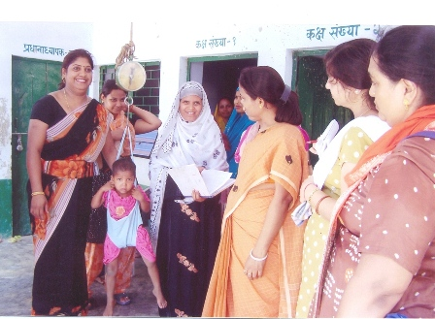
Redesigned Service Package
S. N | Component |  | Service | Core Interventions | Target Group | Service Provider
1. | Early Childhood Care Education & Development (ECCED) | Early Childhood Care and Education (ECCE) / Pre-school Non-formal Education |  | Home based guidance for parents Early stimulation Early Screening and referral Optimal IYCF Practices Monthly Monitoring & Promotion of Child Growth & Developmental Milestones. Fixed Village ECCE Days | 0-3years Parents/caregivers | Second AWW cum Child Care & Nutrition Counselor
 |  |  |  | Non formal preschool education: activity based semi-structured play and learning method Quarterly Monitoring & Promotion of Child Growth & Developmental Milestones. Fixed Village ECCE Days | 3-6 years Parents / caregivers | AWW
 |  | Supplementary Nutrition |  | Morning snack, Hot Cooked Meal and THR as per norms | AWW / Second AWW/ AWH / SHGs / others | 6 m – 3 yrs. 3-6 years P&L Mothers
2. | Care & Nutrition Counseling | Infant & Young Child Feeding (IYCF) Promotion & Counseling |  | One to one counseling for optimal breastfeeding practices One to one counseling on Complementary feeding Counseling to ensure food intake Home visits and follow up | Second AWW / ASHA / ANM | P&L Mothers of children under 3 yrs

Slide 33
Redesigned Service Package cont.
Services Maternal Care Counseling | Core Interventions Early registration of pregnancy, 3 or more ANC, Institutional delivery and PNC Counselling on diet ,rest and IFA compliance during Home visit Monitoring weight gain Examination for pallor and oedema and any danger signs Home based counselling for essential new born care Counselling and lactation support Counselling on spacing | Target Group P&L women | Service Provider ASHA / ANM / MO/Second AWW cum Nutrition Counsellor
Care, Nutrition, Health & Hygiene Education | Monthly health and nutrition education sessions Education on Improved caring practices-- feeding, health, hygiene and psychosocial care. Knowledge sharing for care during Pregnancy, lactation and adolescence Promotion of local foods Appropriate food demonstration Celebration of nutrition week, Breastfeeding week , ICDS day etc. | P&L Mother and other caregivers , community and families | AWW / Second AWW cum nutrition counselor /supervisors
Community based Management of underweight children | Identification of underweight children through weighing 12 day child care counseling & feeding sessions (SNEHA SHIVIRs) 18 day home care and follow-up through Home visit | Moderately and Severely under-weight children & their mothers/caregiver | AWWs/ AWH/ supervisors/ Mothers’ Group/PRIs. / SHGs /MO / ASHA and ANM as facilitator

Slide 34
Redesigned Service Package cont.
3. | Health Services | Immunization | Regular Fixed Monthly VHNDs Primary Immunization ,Boosters TT for Pregnant women Vitamin A & IFA supplementation Deworming Counseling | 0-3 years 3-6 years P&PL Mothers | ANM / MO / ASHA/ AWWs as facilitator
 |  | Health Check Up | ANC / PNC / JSY Support for IMNCI / JSSK Identification of severe underweight children requiring medical attention Support to Community based management of under weight children | 0-3 years 3-6 years P&L Mothers | ANM / MO / Monthly Doctor visits by NRHM at least once in a quarter ASHA /AWWs as facilitator
 |  | Referral Services | Referral of severely underweight to health facility / NRCs Referral for complications during pregnancy Referral of sick newborns Referral of sick children | 0-3 years 3-6 years P&L Mothers | ANM / MO / ASHA/ AWWs
4. | Community Mobilization, Advocacy & IEC |  | Information dissemination & awareness generation on entitlements , program behaviors and practices Sharing of nutritional status of children at gram sabha meetings Linkage with VHSNC Voluntary Action Groups Village contact drives | Families & Community | AWW / Second AWW/ supervisors / FNB / Dist. & Block Resource Centres / ICDS Management

Slide 35
Redefined ECCE
Early stimulation for children under 3 years
Improved infrastructure
Draft National ECCE policy, curriculum framework and quality standards prepared and under finalization and being pilot tested.
New Joyful learning approaches for children 3-6 years old that are developmentally appropriate, with trained AWWs
Detection and referral for delayed development
School readiness interventions for 5 plus year olds –in AWCs or in Schools, as per state context
Monthly Fixed Village ECCE days( local toy bank, community involvement , parent to parent communication, display of activities)
Co-location of AWCs/school where locally decided for better quality and transition

Slide 36
Enhanced Nutrition Impact
Enhanced Cost Norms for SNP
Focus on counseling for maternal care, IYCF,
Focus on growth monitoring and prevention of early onset of undernutrition
Sneha Shivirs : Counseling and care sessions for undernourished children and learning by doing technique for sustained behavior change in care practice.

Slide 37
Strengthening Convergence
Inclusion /linkages of PIPs- NRHM, DS,TSC,SSA
Joint training on thematic areas
Joint review and collateral supervision
Joint monitoring of key results and indicators eg, by the common Village Health Sanitation and Nutrition Committee
Defined roles and accountabilities of frontline workers of different sectors.
Stronger linkages with Health to ensure a continuum of care

Slide 38
Human Resource
Capacity Development
National/State ICDS Mission Resource Centres
Professionalisation of technical and management support at different levels , with specialists on Nutrition, ECCE , Training , Communication and Programme Management recruited as contractual staff
Revamping of training Curricula
Strategic linkages with mother NGOs and Institutions for capacity development.
Notes:
Mission Directorate – 15; National ICDS Mission Resource Centre (NIMRC) – 34; Training Resource Cell – 20; State Mission Directorate (Large states) – 26; State Mission Directorate (Small states) – 15

Slide 39
Promoting Quality and Public Accountability
Introduction of service standards /guarantees
Revised MIS and M&E
Community owned ICDS accreditation system
Incentivisation of panchayats/blocks/districts- through awards like Nirmal Gram Puruskar
Increased public accountability – social audits citizen charters , public hearing

Slide 40
PRI ownership and civil society Partnership
Constitution of Anganwadi Management committees, with PRI women members including mothers and ASHA, with defined roles and linked to common VHSNCs
Common Village Health Sanitation and Nutrition Committees notified. as sub committee of panchayats
Devolution of powers related to ICDS to PRIs and ULBs depending on State context . APIP allows flexibility to States
Assigning 10% of the projects to NGOs/ VOs
Voluntary Action Groups – for Social Mobilization , Communication and support for critical services such as IYCF , Crèches etc

Slide 41
ICDS in Mission Mode
ICDS Mission / Society at National, State and District units
Flexible implementation framework with monitorable outcomes, with
flexibility of state /district specific approaches/models
MOUs between Central/ State governments, and State Annual Implementation Plans
States/districts/blocks and villages empowered to contextualize the programme and build on local capacities and resources
Normative approach with flexibility and demand /need based to address gaps as per standards- entitlements
Performance linked funding
Untied fund for replication of best practices/ innovations, voluntary action, AWC cum crèche, pilots through APIP.

